Slide 1
File Management system
Anit Chaudhary [BEIT(Mrng.) 12402 ]
Bipin Subedi [BEIT(Mrng.) 12402 ]
Suresh Pokhrel [BEIT(Mrng.) 12448 ]

Slide 2
Outline
Scope & Problem statement
Project Objective
Architectural Skeleton
Requirement
Roles
System Design

Slide 3
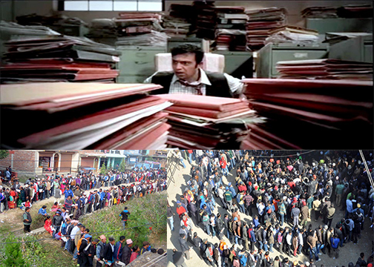
Scope & Problem statement

Slide 4
Project Objective
Easy Interface
Effective Navigation
Chatting with peers
CRUD(Create, Read, Update , Delete, ) facility

Slide 5
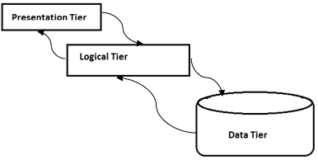
Architectural Skeleton

Slide 6
Presentation Tier
Eye fascinating interface
Browsing in Web Browser
HTML/JSP, CSS and JavaScript

Slide 7
Logical Tier
Mapping and redirecting the web pages
Maintain database by hibernate
SessionContext Maintained
MVC Architecture

Slide 8
Data Tier
Hibernate to access/retrieve database
MySQL database
JDBC connector

Slide 9
Functional Requirement
Requirements | Priority
Users enables with login environment | Needed
Users can a upload of files | Needed
Users can chat with each other | Needed
Database stores the user’s data files as well as predefined data sets | Needed
System shows message notification | Needed
System shows as per their online status | Optional

Slide 10
Non-Functional Requirement
Requirements | Priority
Users enables with login environment | Needed
Users can a upload of files | Needed
Users can chat with each other | Needed
Database stores the user’s data files as well as predefined data sets | Needed
System shows message notification | Needed
System shows as per their online status | Optional

Slide 11
Roles
Developer and SQA | Anit Chaudhary
Designing, Project Manager | Bipin Subedi
Documenting ,Testing | Suresh Pokhrel

Slide 12
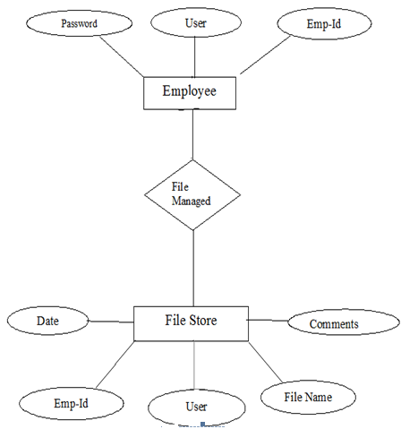
System Design
Entity Relationship Diagram

Slide 13
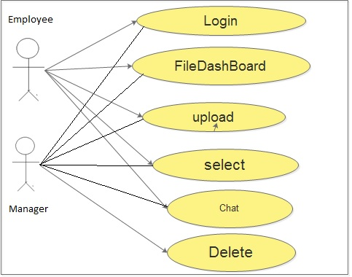
Use case diagram

Slide 14
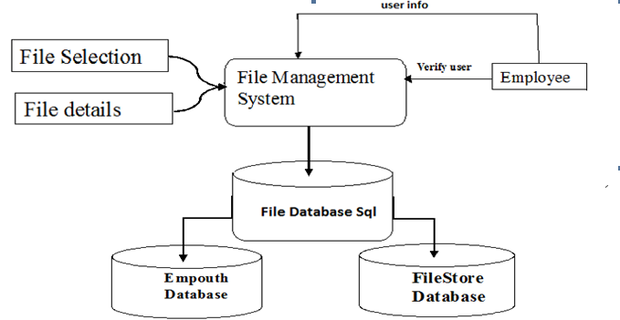
DataFlow Diagram

Slide 15
Thank you ☺

Slide 16
Queries So far???

